Slide 1
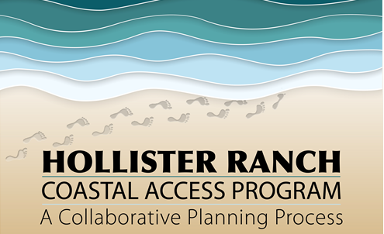
Hollister ranch – coastal access program planning update
CALIFORNIA COASTAL COMMISSION
STATEWIDE COASTAL ACCESS PROGRAM Item W7e 3.11.20 Slide 1

Slide 2
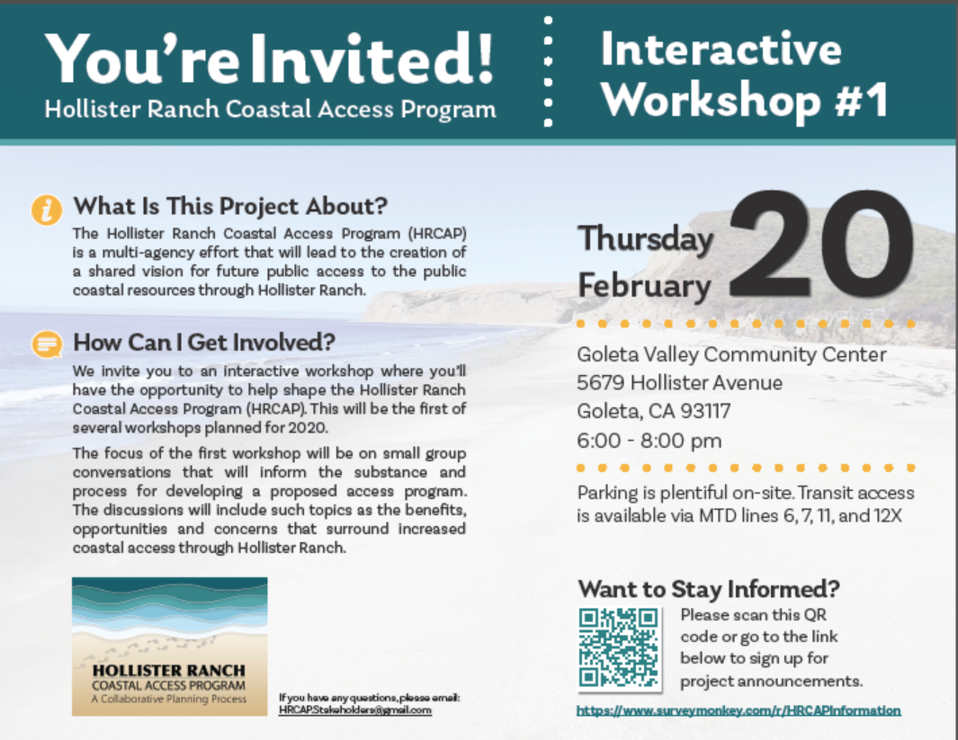
CALIFORNIA COASTAL COMMISSION
STATEWIDE COASTAL ACCESS PROGRAM Item W7e 3.11.20 Slide 2

Slide 3
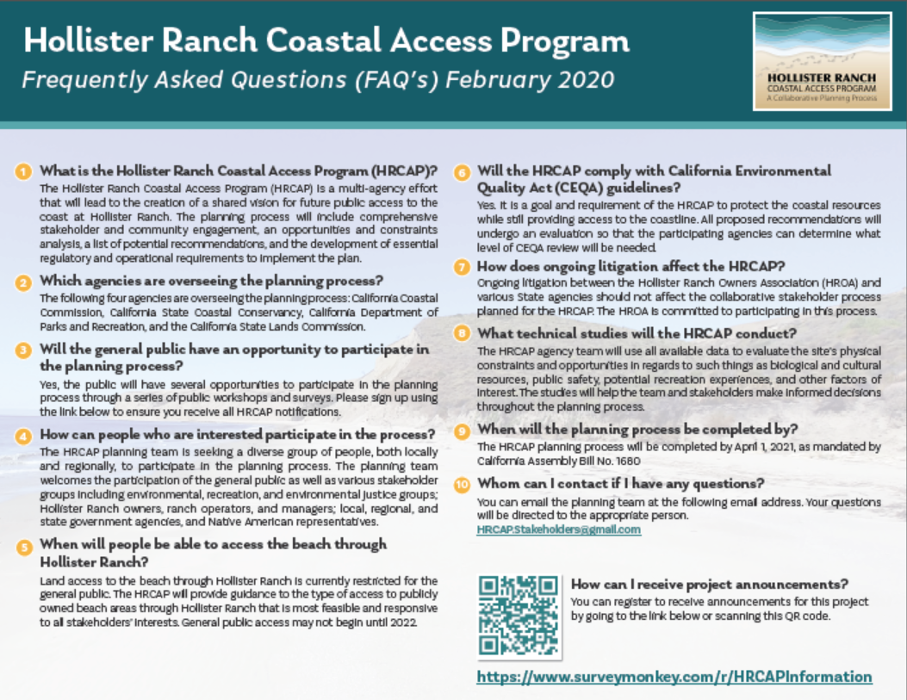
CALIFORNIA COASTAL COMMISSION
STATEWIDE COASTAL ACCESS PROGRAM Item W7e 3.11.20 Slide 3

Slide 4
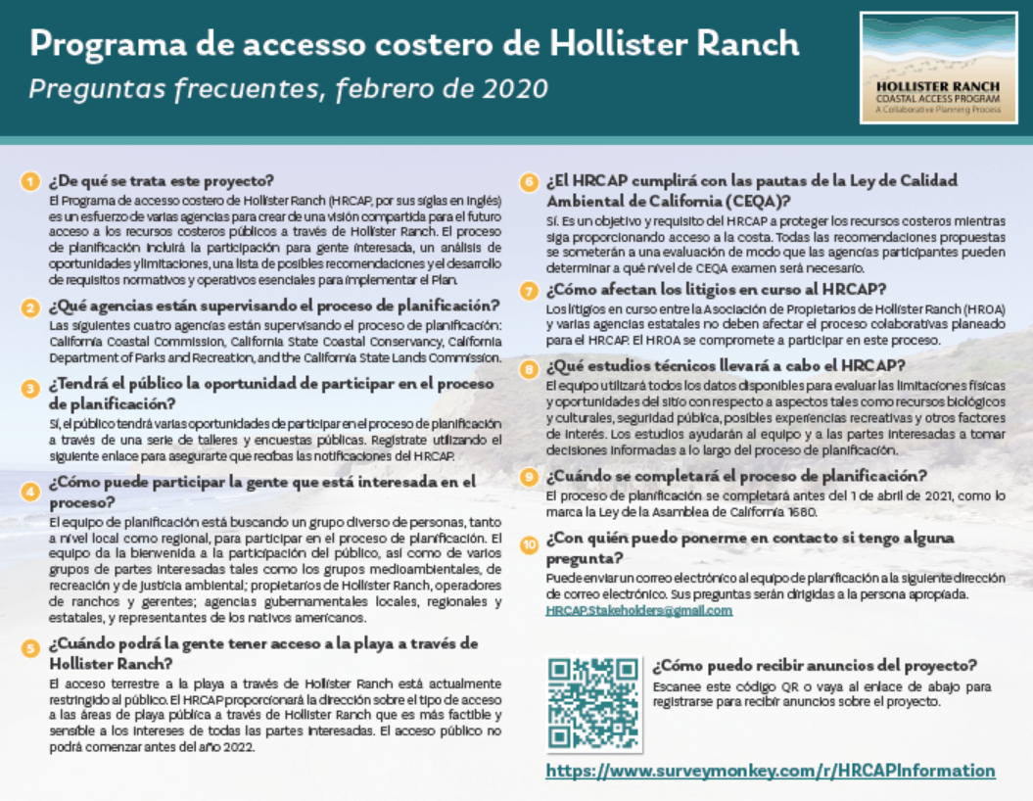
CALIFORNIA COASTAL COMMISSION
STATEWIDE COASTAL ACCESS PROGRAM Item W7e 3.11.20 Slide 4

Slide 5
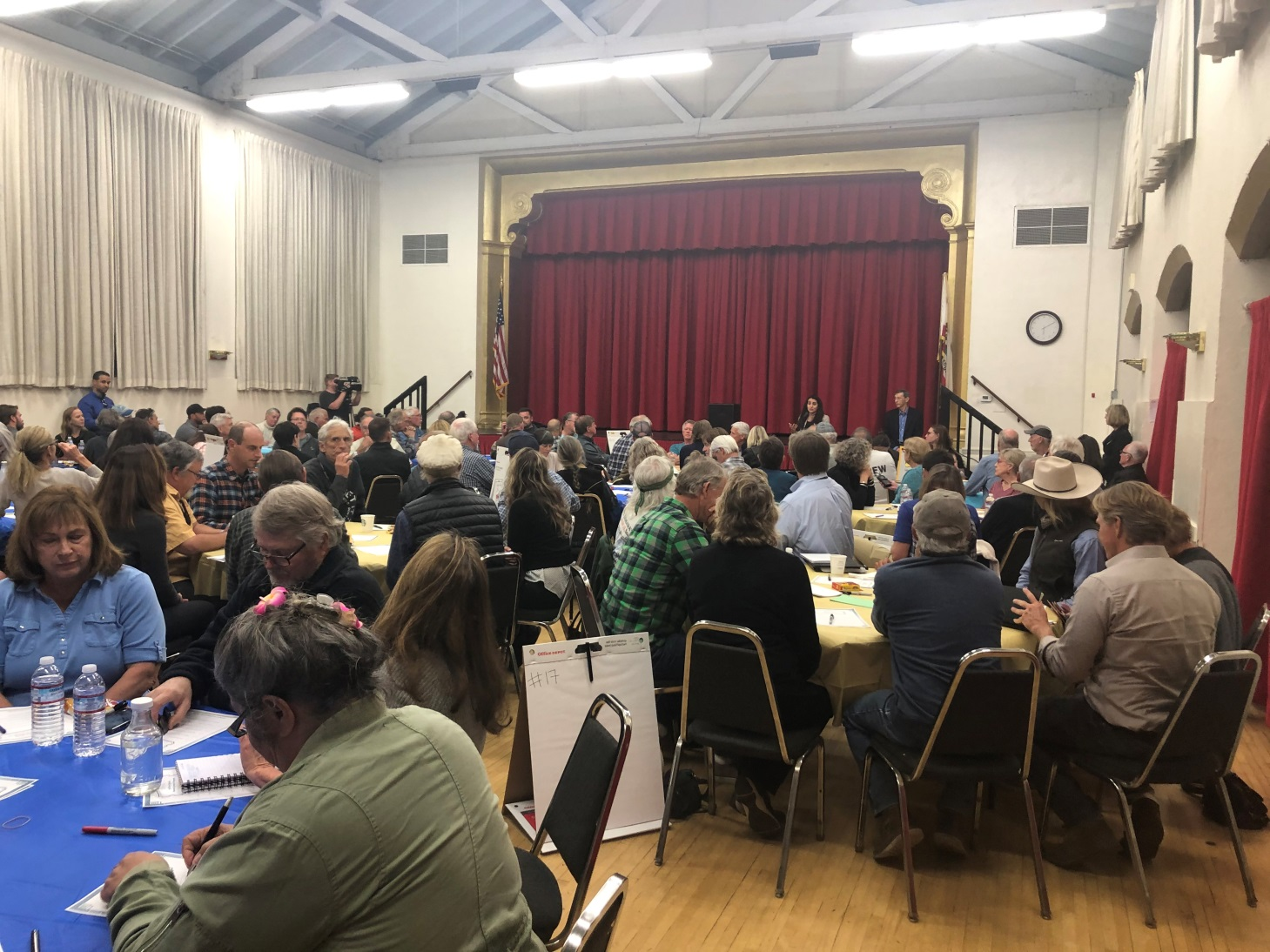
interactive workshop # 1
Goleta, Ca 2.20.20
CALIFORNIA COASTAL COMMISSION
STATEWIDE COASTAL ACCESS PROGRAM Item W7e 3.11.20 Slide 5

Slide 6
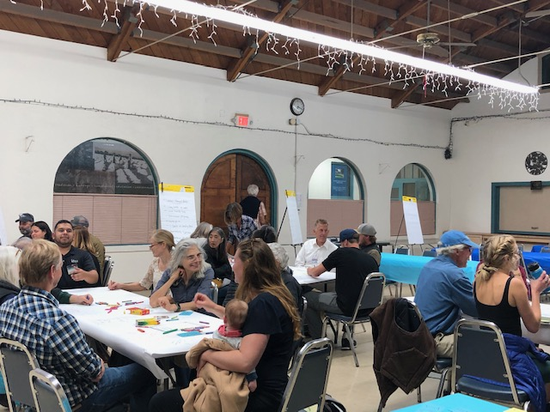
interactive workshop # 1
Goleta, Ca 2.20.20
CALIFORNIA COASTAL COMMISSION
STATEWIDE COASTAL ACCESS PROGRAM Item W7e 3.11.20 Slide 6

Slide 7
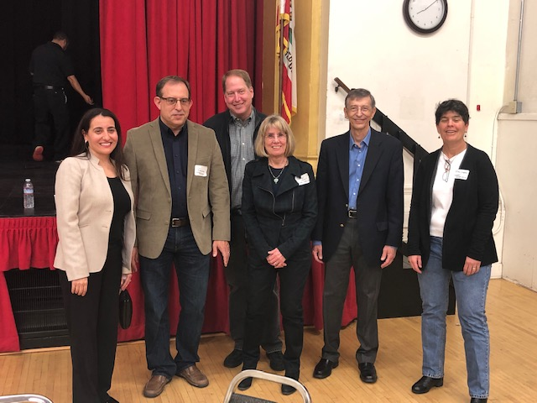
interactive workshop # 1
Goleta, Ca 2.20.20
CALIFORNIA COASTAL COMMISSION
STATEWIDE COASTAL ACCESS PROGRAM Item W7e 3.11.20 Slide 7

Slide 8
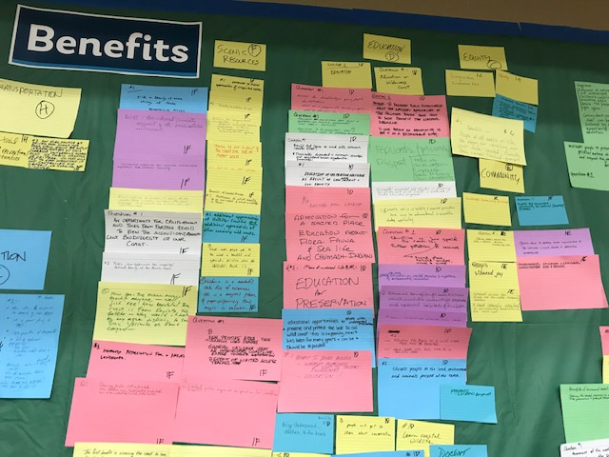
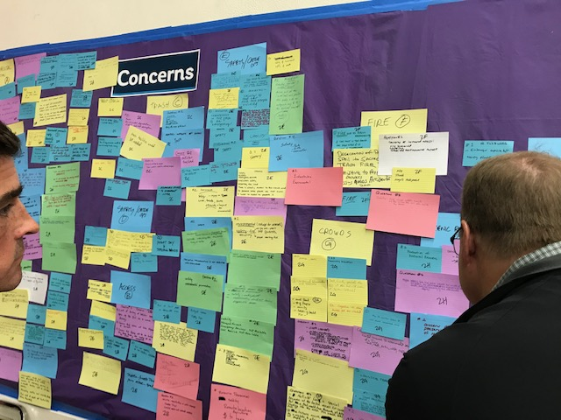
interactive workshop # 1
Goleta, Ca 2.20.20
CALIFORNIA COASTAL COMMISSION
STATEWIDE COASTAL ACCESS PROGRAM Item W7e 3.11.20 Slide 8

Slide 9
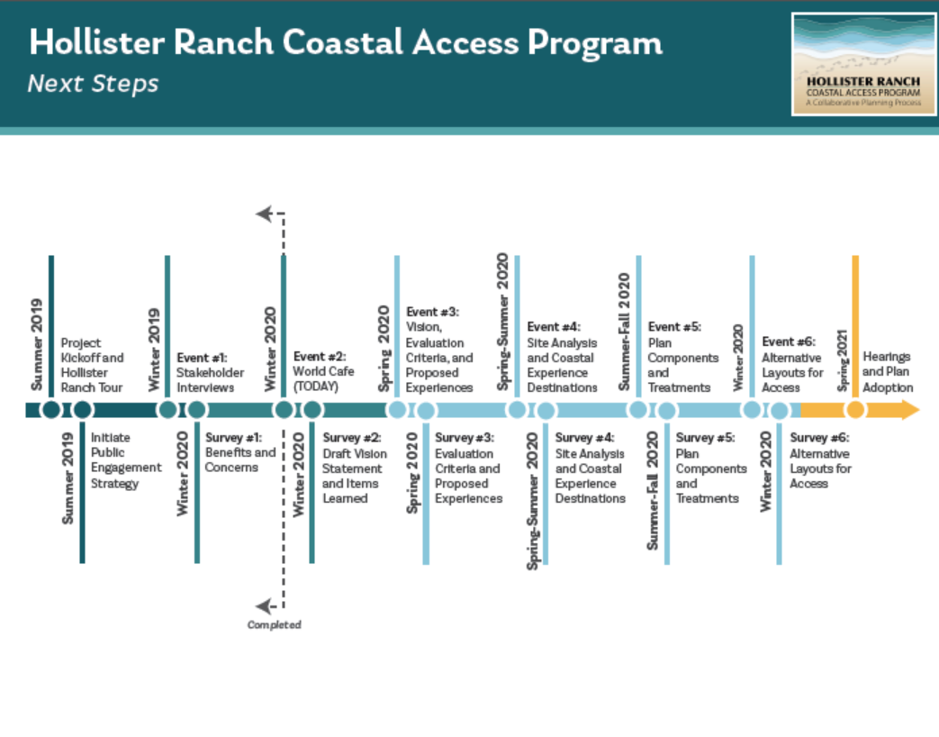
planning timeline 2020- 2021
CALIFORNIA COASTAL COMMISSION
STATEWIDE COASTAL ACCESS PROGRAM Item W7e 3.11.20 Slide 9

Slide 10
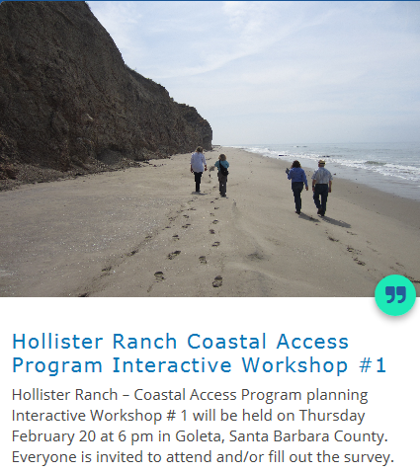
CCC website:
https://www.surveymonkey.com/r/HRCAPInformation
https://www.coastal.ca.gov/
CALIFORNIA COASTAL COMMISSION
STATEWIDE COASTAL ACCESS PROGRAM Item W7e 3.11.20 Slide 10

